Slide 1
How Internet Works
Anil Sakala

Slide 2
How internet works (Simplified Diagram)
Server (Computer that serves Requests and contains Web pages)
Data Cable
Server (Computer that serves Requests and contains Web pages)
Client (Sends request using browser)

Slide 3
How internet works (More Simplified Diagram)
Client (Sends request using browser)
Server (Computer that serves Requests and contains Web pages)
Http Request
Http Response

Slide 4
How internet works (Detailed Diagram)
Conventional way – Requirements , Freeze Code and Test
Disadvantages :
Quality is a concern :
Defects
Maintainenece (No safety net)
Solution : TDD
Changing requirements – Changing business rules
Better way of communicating between developers and testers
Solution : ATDD
Above problems can be overcome very easily by being test driven

Slide 5
How internet works (More Detailed Information)
Server (Computer that serves Requests and contains Web pages)
Http Request
Http Response

Slide 7
Conventional way of developing software - Disadvantages
Conventional way – Requirements , Freeze Code and Test
Disadvantages :
Quality is a concern :
Defects
Maintainenece (No safety net)
Solution : TDD
Changing requirements – Changing business rules
Better way of communicating between developers and testers
Solution : ATDD
Above problems can be overcome very easily by being test driven

Slide 8
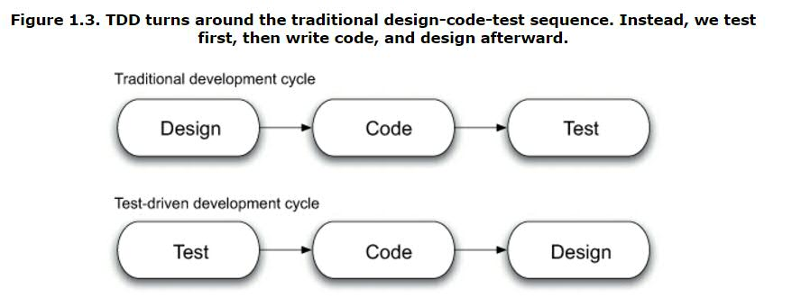
Being test driven
Test Driven = TDD + ATDD
TDD :
Lifecycle of TDD – Test , Code , Refactor
Only ever write a code to fix a failing test
Above problems can be overcome very easily by being test driven

Slide 9
TDD
Tools that help you writing this kind of code – Junit , TestNG , Mocking Frameworks
Advantages :
Every object will have test object . This works like safety net
Thorough testing and immediate defects
Easy maintainenece
Example : Check if a given String is palindrome or not

Slide 10
ATDD
Conventional – Feature as requirement document , Code , Test , Customer acceptance test
ATDD : Convert the requirement document to a set of acceptable tests and then build your system against these tests
There are different tools available for this – Cucumber and Fit tool.
How cucumber helps you in building
Living document
Reduces gap between developers and BA’s
Trigger your test suite – Starts validating document against system
Summary :
Write AT tests , Run Them , Build system to satisfy these tests

Slide 11
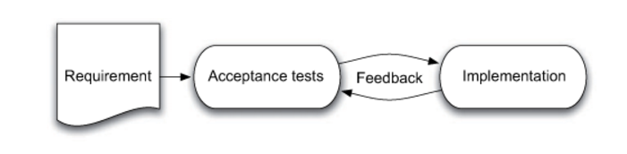
ATDD

Slide 12
Conclusion
TDD and ATDD improve the quality of work
References
Test Driven: Practical TDD and Acceptance TDD for Java Developers

